Slide 1
PySpark Integration
Hive and Cassandra

Slide 2
Agenda
Apache Spark Integration
Why we need Integration
What is ETL
PySpark Integration with Hive
PySpark Integration with Cassandra
Lab - Implementation

Slide 3
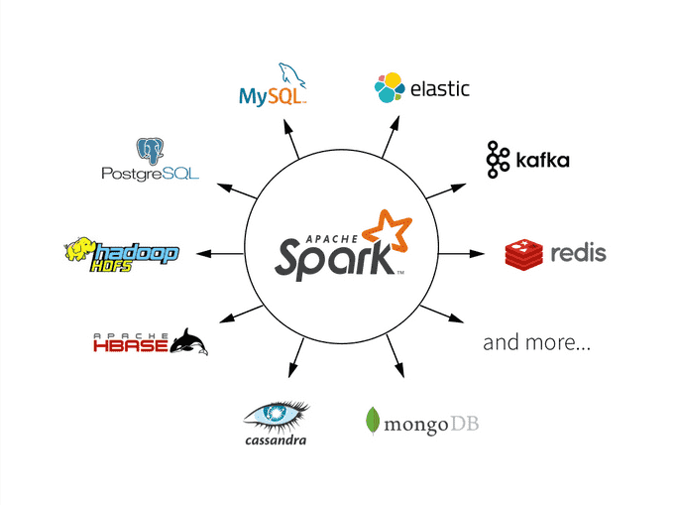
Apache Spark Integration
What is Integration
Read/Write data from anywhere
Easy to integrate with Hadoop tools
Like Hive etc.
Easy to integrate with Cloud Platform
Like AWS, GCP and Azure

Slide 4
Why we need Integration with Spark
To make faster data Processing
Sometimes we need to process petabytes of data but data is stored in a particular server. When we process data on that server here it will take lot of time. In that case we need to integration with spark to fast data processing.
Eg. Hadoop process data in 100 min but when we integrate spark with Hadoop then it will take 10 mins to process data.

Slide 5
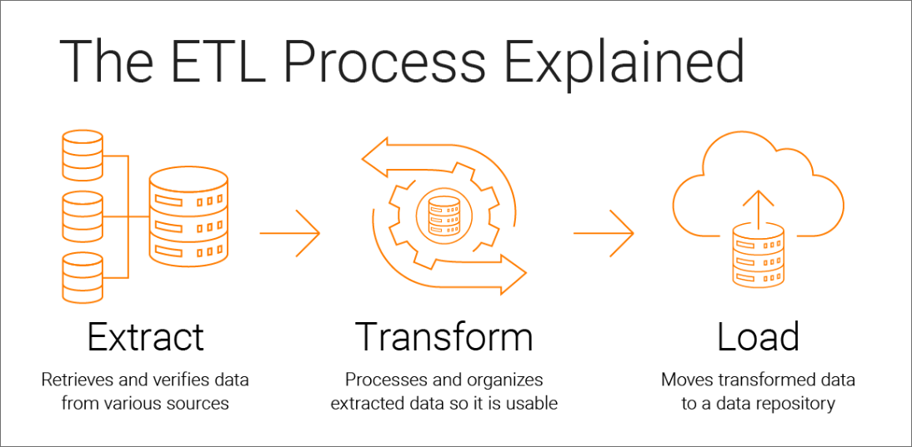
Extract, Transform and Load (ETL)
ETL is used for data Pipeline.
Extract:-
Extract data from servers, database, etc.
Transformation:
Transform extracted data from the source.
Load:
Ingest transformed data to the destination.

Slide 6

Hive - Introduction
Hive is a data warehouse system that is used for querying and analyzing large datasets stored in HDFS.
It process structured and semi-structured data in Hadoop.
Hive allows users to read, write, and manage petabytes of data using SQL
Uses SQL-like query language called HiveQL.
Hive is built on top of Apache Hadoop, which is an open-source framework used to efficiently store and process large datasets. As a result, Hive is closely integrated with Hadoop, and is designed to work quickly on petabytes of data.
Using hive process many kinds of files formats.
Like csv, json, avro, html, xml, parquet etc

Slide 7

Why PySpark Integration with Hive?
Hive is the best option for performing data analytics on large volumes of data using SQLs. Spark, on the other hand, is the best option for running big data analytics
Spark + Hive:
provides a faster data processing
modern alternative to MapReduce

Slide 8

Cassandra - Introduction
Apache Cassandra is a free, open-source, NoSQL, distributed data storage system.
It is a column-oriented database.
It is scalable and fault-tolerant : means no single point of failure
Consistent access and availability
Offers users “blazingly fast writes,” and the speed or accuracy is unaffected by large volumes of data
Horizontal scalability. Its structure allows users to meet sudden increases in demand, as it allows users to simply add more hardware to accommodate additional customers and data.
linear scalability: to maintain the system’s quick response time.

Slide 9
More benefits of Cassandra
Flexible data storage. Cassandra can handle structured, semi-structured, and unstructured data, giving users flexibility with data storage
Flexible data distribution. Cassandra uses multiple data centers, which allows for easy data distribution wherever or whenever needed.
Supports ACID. The properties of ACID (atomicity, consistency, isolation and durability) are supported by Cassandra.

Slide 10
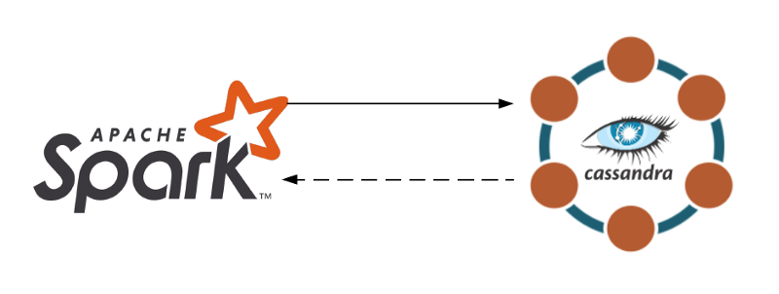
Why PySpark Integration with Cassandra?
Allows Spark to fully take advantage of Cassandra as well as use Cassandra-specific Spark optimizations
Increase the efficiency of your application
To utilize the power of these two great tools

Slide 11
Lab - Implementation
Start integration with Hive
Start Integration with Cassandra.

